Slide 1
2024 - 2025 Financial Aid High School Presentation
New Jersey Higher Education Student
Assistance Authority
Catherine M. Boscher-Murphy

Slide 2
The Mission
The Higher Education Student Assistance Authority is the only State agency with the sole mission of providing students and families with the financial and informational resources to pursue their education beyond high school.
Financial Aid High School Presentation - 2
Notes:
HESAA Information Detailed:
Financial aid session
FAFSA Days
Booklets: State and Federal Aid, Financial Aid Dictionary, Student Loan Guide, and Reach Higher the College Planning Booklet.
Handouts: Eight Steps to Apply, Financial Planning Chart, and program brochures are available for free.
REAL $ 101 Financial Literacy on-site Sessions

Slide 3
Goals of Financial Aid Office
Primary goal is to assist students in paying for college and is achieved by:
Evaluating family’s ability to pay for educational costs
Distributing limited resources in an equitable manner
Providing a balance of gift aid and self-help aid
Implementing federal and state regulations for their college/university
Notes:
Gatekeepers of the financial aid funds.

Slide 4
What is Financial Aid
Includes all funds made available to students not paid directly by the family

Slide 5
Financial Aid
Types of Financial Aid
Sources of Aid
Grants
Scholarships
Loans
Employment Opportunities
Federal
State of New Jersey
The College/University
Outside Organizations
Civic organizations (ex.-local Rotary Club), parent’s employer, high school awards

Slide 6
Grants
Gift Aid
Does not have to be repaid
Typically based on need

Slide 7
Scholarship
Gift Aid
Does not have to be repaid
Typically based on merit or a skill
Academic achievement
Athletic ability

Slide 8
Student Employment
Offered by college
Part-time job
Paid for hours worked
Not applied to college bill

Slide 9
Loans
Borrowed funds must be repaid
Student loans
Parent loans
Private loans
Interest and repayment plans differ by program
Borrow wisely

Slide 10
Types of Aid - Federal
Pell $7,395 (max award)
SEOG $4,000 (max award)
TEACH $3,772 (max award)
Stafford Direct Student Loans
Parent PLUS Loans
2023-2024 Award amounts
Notes:
PELL- SEOG
Named after senator Pell of Rhode Island, Pell is covered under the Higher Education Act of 1965
Pell is need based and all those with an EFC low enough are eligible so long as he or she has not received a first bachelor’s degree yet or are enrolled in a post baccalaureate program that leads to a teacher’s certification or licensure
Currently, the maximum amount is $6,895. The amount of the award will depend on financial need, cost of attendance, and full time or part time status
The limit on Pell is 12 semesters of full-time work (roughly 6 years)
SEOG can range from $100 to $4000 – funding is provided by the US Department of Education to institutions to manage. Goes to most needy first and are very limited.
The TEACH Grant As a condition for receiving a TEACH Grant, you must sign a TEACH Grant Agreement to Serve in which you agree to (among other requirements) teach
in a high-need field
at an elementary school, secondary school, or educational service agency that serves students from low-income families
for at least four complete academic years within eight years after completing (or ceasing enrollment in) the course of study for which you received the grant.
Iraq and Afghanistan Service Grants
The Iraq and Afghanistan Service Grant is provided to certain students whose parent or guardian was a member of the U.S. armed forces and died as a result of military service performed in Iraq or Afghanistan after the events of 9/11. May not be eligible for a federal PELL Grant but must meet remaining eligibility requirements.
https://studentaid.ed.gov/sa/about/announcements/sequestration#iraq-afghanistan

Slide 11
Types of Aid – State of NJ
NJ Tuition Aid Grant (TAG)
Educational Opportunity Fund (EOF)
Garden State Guarantee (GSG)
NJ Stars and Stars II
Governor's Urban Scholarship (GUS)
Governor’s Industry Vocation (NJ – GIVS)
NJ CLASS

Slide 12
Types of Aid – State (cont.)
Community College Opportunity Grant (CCOG)
Garden State Guarantee (GSG)
Covers tuition and fees minus all other grants and scholarships
Tier I - AGI between $0 - $65,000 for maximum award
Tier 2 - AGI between $65,001 - $80,000 (student liable for $7500 T&F)
Tier 3 - AGI between $80,001 - $100,000 (student liable for $10,00 T&F)
Notes:
Complete an NJ – GIVS application at njgrants.org
Eligible certificate or degree program

Slide 13
CCOG/GSG Calculation
Full-time tuition and mandatory fees minus other grants, scholarships, etc. (not loans or aid designated specifically for housing, books)
Tier 1: Tier 2: Tier 3:
T & F: 14764 14764 14674
Grants: -12000 -7500 pd by student -10000 pd by student
GSG: 2764 7264 4674
Notes:
Complete an NJ – GIVS application at njgrants.org
Eligible certificate or degree program

Slide 14
3 + 1 Degree Completion Programs
Student enrolls in a bona fide 3 + 1 major/degree program
Student completes the first two years at the community college and earns an Associate Degree
Pays community college tuition and fees for the associate degree and the third year of their program
Attends and pays the four-year institution tuition and fees in the final year
Notes:
Rowan at Burlington CC
Thomas Edison with all CC’s

Slide 15
Types of Aid – Institutional Programs & Private Scholarships
Factors that may influence eligibility:
Academics | Athletic Ability*
SAT’s | Geographic Diversity
AP Courses | Legacy (child of alumni)
Activities | Talent
Academic Track | Gender/Ethnicity
H.S. Attended | Class Rank
* Athletic awards offered by NCAA Division I and Division II schools only.

Slide 16
Am I Eligible?
US Citizen or legal resident
HS Diploma or GED
Valid Social Security number (student)
Enrolled in eligible program
Degree/certificate program
Eligible institution
For NJ programs – must be resident of NJ 12 months prior to beginning college

Slide 17
How do I Apply?
FAFSA
Free Application for Federal Student Aid
6000+ colleges/schools require
College Board CSS Profile
About 400 schools require this supplemental form
Institutional forms

Slide 18
When do I Apply?
FAFSA –
https://studentaid.gov
Normally available 10/1 in fall of high school senior year
Priority deadlines vary for each college
Meet the earliest deadline
NJ Alternative Application -
www.hesaa.org
Normally available 10/1 of high school senior year
CSS Profile -
www.student.collegeboard.org/profile
Varies by school

Slide 19
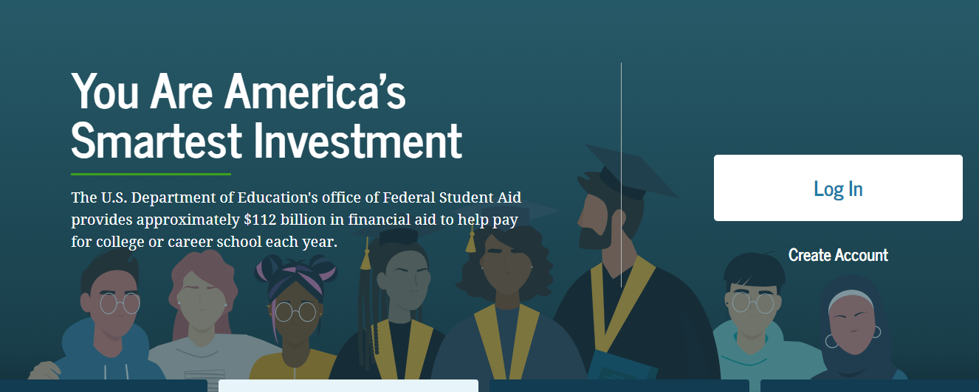
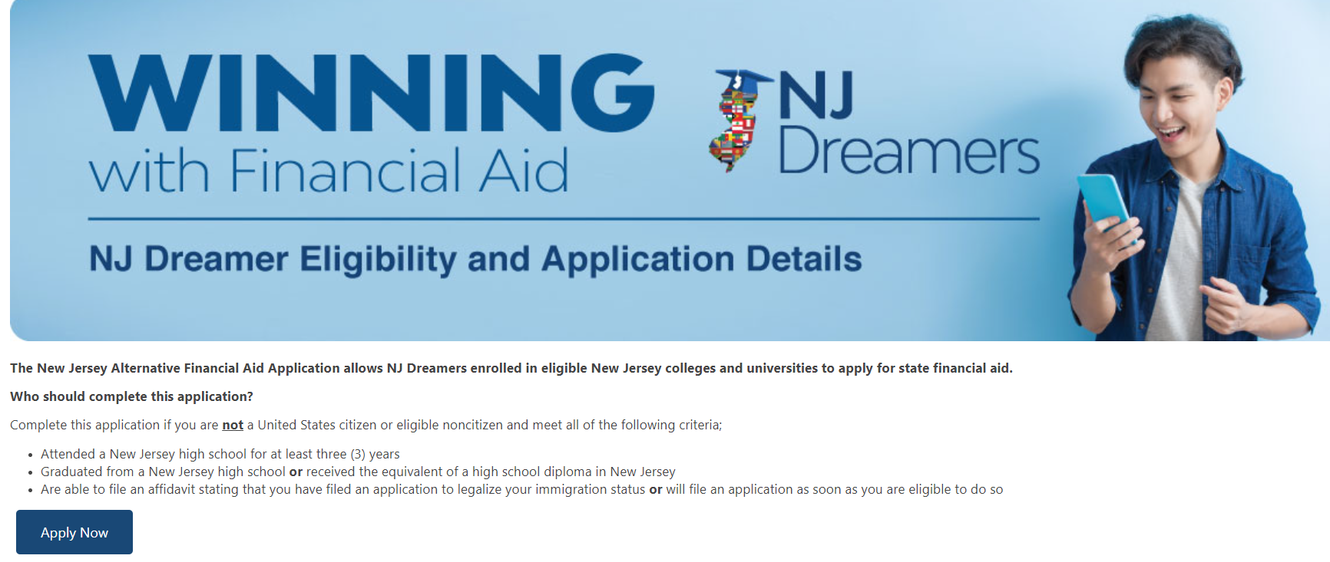
Applications to Access Aid
studentaid.gov
student.collegeboard.org/profile
HESAA.org

Slide 20
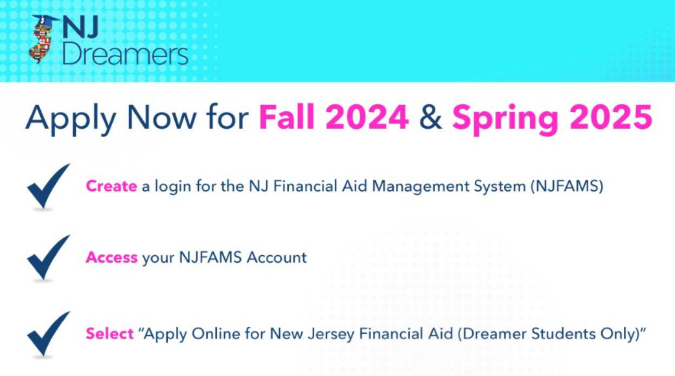
New Jersey Dreamers
All students must go to https://njfams.hesaa.org
Register for your account by creating a User ID and Password
Log in to complete the application by established deadlines.

Slide 21
NJ Alternative Application
The NJ Alternative Financial Aid Application allows undocumented students enrolled in eligible NJ colleges to apply for state grants (TAG, EOF, Stars, etc.)
If you are NOT a US citizen or eligible noncitizen and meet the following criteria:
Attended a NJ high school for at least three years
Graduated from a NJ high school or received the equivalent of a high school diploma
Able to file an affidavit at the college stating you will file an application to legalize your immigration status as soon as you are eligible to do so

Slide 22
Federal Student Aid ID Get a Log-In
All contributors must create a Federal Student Aid ID (FSA ID) at www.studentaid.gov - create account
Contributors include student, parent(s), stepparent, or spouse if student is married
Each person must be verified by a mobile phone number or email when creating the FSA ID
Use every year
Use to apply for the FAFSA or federal loans
Notes:
The FSA id is a higher security login which will connect the student and parent to the FAFSA. The FSA id will also connect the student to the federal student aid website, and the National student loan data base.

Slide 23
2024-2025 FSA ID
Student Identifies who the information contributor(s) are and invites them to contribute to the FAFSA. Each contributor must have an FSA ID and password.
Parental Contributors include: Biological Parent, Stepparent, and Adoptive Parent
One parent if parents filed jointly
Parent who provided more financial support in the last 12 months
• If married or unmarried/living together but did not file taxes
jointly, then both contributors will need an FSA ID
All contributors must be verified by individual email when creating the FSA ID
Notes:
The FSA id is a higher security login which will connect the student and parent to the FAFSA. The FSA id will also connect the student to the federal student aid website, and the National student loan data base.

Slide 24
2024-2025 FSA ID for Undocumented Contributors
Information Contributors with an ITIN number must use the ITIN number to create their FSA ID and will have to verify identity.
Information Contributors who do not have a SSN will register with all zeros and will have to verify identity through a knowledge based verification process.
All contributors must be verified by individual email when creating the FSA ID
Information Contributors who cannot verify identity must contact FSA to submit documentation and if still cannot verify identify must complete a paper FAFSA
Notes:
The FSA id is a higher security login which will connect the student and parent to the FAFSA. The FSA id will also connect the student to the federal student aid website, and the National student loan data base.

Slide 25
Free Application for Federal Student Aid (FAFSA)
2024-2025 “A Better” FAFSA is available
December 2023
Collects family’s personal and financial information used to calculate the student’s Student Aid Index (SAI)
File the FAFSA electronically via FAFSA on the Web at www.studentaid.gov
FAFSA Uses prior-prior year income information (2022)

Slide 26
On the FAFSA
Each contributor must provide consent to IRS to obtain Federal Tax Information
Data from IRS will populate into the FAFSA
Will not see the data (cloaked for security)

Slide 27
Federal Tax Information Consent

Slide 28
Federal Tax Information (FTI)
The IRS will request consent to retrieve your Federal Tax Information (FTI) into the FAFSA
The FTI will be available beginning December 2023 to support the Better FAFSA
If married or unmarried/living together but did not file taxes jointly, then both will need to log in to provide consent to retrieve federal tax information
Notes:
6

Slide 29
Who is the Parent(s)
Single
Unmarried, living together – biological parents
Married or remarried – as of date of FAFSA
This means stepparent
Separated or Divorced –
Parent Wizard on FAFSA will determine which parent the student must put on the FAFSA (parent that provides more support)
Widowed
Notes:
6

Slide 30
Key Components of the FAFSA
Student Contributor Section
Full Name, address
Social Security Number
Date of Birth
Email address
College plans
Student Income and Assets
IRS Consent
Income earned from work
Student Status: Dependent/Independent
Notes:
6

Slide 31
Key Components of the FAFSA (cont.)
Parent Contributor(s) - Who is a Parent?
Social Security Number
Last Name, First initial
Date of Birth
Email address
Federal Means Tested Benefits
Medicaid, SSI, SNAP, Free or Reduced Price School Lunch, TANF, WIC, EITC, QHP (qualified Health Plan)
Family Size – from IRS return (exemptions)
Notes:
6

Slide 32
Key Components of the FAFSA (cont.)
Parent(s) Income
IRS FTI
Income earned from work
Dislocated Worker
Assets
Cash, savings, checking accounts
Investments = money markets, CD’s, stocks, bonds, property, second home
Business or farm
Notes:
6

Slide 33
Other Assets
529 Accounts
If parent or student owns the 529 account, include the value of account designated for the student (exclude other 529 accounts for other kids)
Child Support
Notes:
6

Slide 34
Do Not Include
Retirement accounts
The total value of a 401K, 403B, IRA, etc. is not listed anywhere on the FAFSA
However – any pension distributions are considered income as reflected on the tax return
Primary Home
If you live in a single family home, the value of that home is not listed anywhere on the FAFSA
However – if you own a multi-family home, the portion you do not live in is considered an asset
Notes:
6

Slide 35
Don’t Get Confused
For the 2024-25 year:
Income information = 2022 tax data
Savings/investments = current
(as of date of FAFSA filing)
Family Size = pulled from tax return
if different for coming year, can manually change

Slide 36
Click to Apply for State Aid
2023 - 2024
New Jersey State based
This link redirects filers to view instructions regarding the NJFAMS Student Portal. Applicants are instructed to log into “NJFAMS.HESAA.org” to create a user ID and password. In 3-5 business days, students can their check awards and eligibility status and complete any outstanding items on their “To Do” list (There is no State Application only a To-Do-List).
Please note, all notifications will be sent to the student email address listed on the FAFSA.

Slide 37
NJFAMS
All students must go to “NJGRANTS.org”
Establish an NJFAMS Account by creating a User ID and Password
Notes:
6

Slide 38
Federal & State Verification
Students are randomly selected, however, using the IRS DATA Retrieval Tool will reduce the likelihood of being selected
SCHOOL is responsible for verifying information for federal aid except for special circumstances
HESAA is responsible for verifying information for State aid
Schools may send request for information by mail or e-mail
Always check your school account and NJFAMS account for required tasks
Be sure to meet verification deadlines
Notes:
6

Slide 39
Common Mistakes
Student’s name as it appears on the social security card, social security number, and date of birth
Number of people in the family
Divorced/remarried households
Taxes paid vs. taxes withheld
Including untaxable social security benefits
Parental and student assets
“Zero” is an answer
College grade level – NOT a graduate student
Filing an application for the incorrect academic year
Filing the wrong application based on student immigration status
Notes:
6

Slide 40
Three Key Terms
SAI
Student Aid Index
COA
Cost of Attendance
Need
Notes:
6

Slide 41
What Is The Student Aid Index (SAI)?
SAI is determined by a federal formula that calculates need using the information you supplied on the FAFSA
SAI is used to create your financial aid package
SAI & Financial Need are guidelines used by schools to determine an aid package
SAI measures your family’s financial strength

Slide 42
Cost of Attendance
Tuition and fees - direct
Room and food – direct or indirect
Books, supplies, equipment – direct but not billed
Federal loan fees - direct
Transportation – indirect
Miscellaneous – indirect
Notes:
6

Slide 43
Unexpected Costs
Remediation Classes: extra 1 – 2 semesters
Change in major: 1 – 2 years in addition
Transferring: possible extra semester
Unpaid internships: loss of Summer wages
Study Abroad, Spring break, trips home and pledging costs
Moving expenses and Summer storage
43

Slide 44
Determining Aid Eligibility
COA
SAI
NEED
Notes:
6

Slide 45
Financial Aid Packaging
There is a standard order of who aid is packaged:
Entitlement/formula driven awards
Pell Grants
NJ TAG Grants
Other federal aid (SEOG, FWS)
Federal Stafford Direct Student Loans
Institutional aid
Notes:
6

Slide 46
Sample EFC for Smith Family
Family lives in New Jersey
Married parents filing jointly
Household size of 4
2022 adjusted gross income = $94,002
Assets = $0
Student income / assets = $50 / $213
SAI = 8,667
$0 federal Pell grant
Family lives in New Jersey
Married parents filing jointly
Household size of 6
2022 adjusted gross income = $94,002
Assets = $0
Student income / assets = $50 / $213
SAI = 3,764
$3,635 federal Pell grant
Federal Student Aid Estimator: https://studentaid.gov/aid-estimator
46

Slide 47
Financial Need for Smith Family
College | Community College | State College or University | Private College or University
COA | $8,000 | $30,000 | $60,000
SAI and other aid | $1,500 | $1,500 | $1,500
Financial Need | $6,500 | $28,500[ | $58,000
47
Notes:
All examples include approximate tuition, fees (left out new student fee), room and board for academic year.

Slide 48
NJ Shopping Sheet or Federal College Financing Plan
Help families with transparency
Separates the Cost of Attendance listing the direct and indirect costs
Awards – Grants & Scholarships (free no repayment required)
Student Final Costs box
College coordinated work study
Federal Student Loans
If necessary alternate loans

Slide 49
Comparing Offers
Look at the bottom line
Direct expenses minus grant aid
Direct expenses minus grant and student loans
How much can you afford?
A more expensive school can actually cost less

Slide 50
Net Price Calculator
All institutions must have a net price calculator posted on their websites.
Students will be able to estimate the individual net price per institution.
Based on full-time, first degree/certificate-seeking undergraduate students.
Notes:
HESAA also has on the website the NJEI calculator that calculates TAG for estimate purposes only.

Slide 51
Other Resources
Outside Scholarships
Campus Administered Payment Plans
Campus Employment
Private Loans
529 Plans
Specialized Campus Opportunities
Residential Advisors
Student Ambassadors
Student Tour Guides
Internships/CO-OP’S

Slide 52
Private Scholarship Search
Institution/college web sites
Local library resources
Local businesses, civic organizations and churches
Check with your High School guidance office
Parent’s employer(s)
www.hesaa.org
www.fastweb.com
www.collegeboard.org
www.mappingyourfuture.org

Slide 53
Consumer Issues
Renewability of awarded aid
Minimum GPA?
Need-based aid
Will changes in need from year to year cause an adjustment?
Treatment of outside scholarships
Reduce loans or institutional aid
Scholarship scams
Consultants - good or bad idea?
Aid Notifications - review them carefully

Slide 54
Special Circumstances
Significant change to family situation
Loss of Income
Retirement, unemployment, company closing
Separation/divorce of parents
Death/disability of parent
Every school treats these differently
Federal regulations allow lots of leeway
Different rules for NJ Grants too

Slide 55
The Cycle of Financial Aid
Oct - March | Complete FAFSA application, college search, college application process, and CSS Profile For 24-25, FAFSA will be available in December 23.
February - May | Schools send FA notification letters
June - July | School sends Fall Semester bill
August | Bills are due to institution

Slide 56
Apply for State Aid Workshops & Webinars
Please join us for a virtual FAFSA Completion Workshop.
Check back for schedule events starting in September 2023.
Link to monitor: https://www.hesaa.org/Pages/FAFSA.aspx
Pre-recorded Webinars

Slide 57
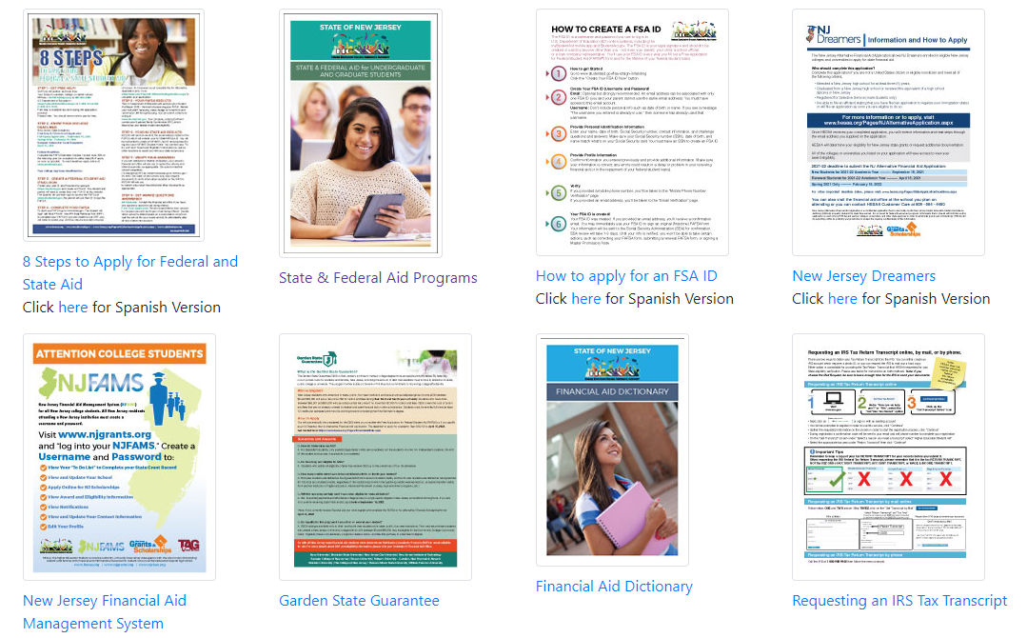
HESAA Publications

Slide 58
HESAA Services
Customer Care Center - CustomerCare@hesaa.org
Customer Care Line
609-584-4480
Monday – Thursday 8:30 – 8 and Friday 8:30 – 5:00
Web Sites
www.hesaa.org
www.njgrants.org
www.njclass.org
https://njfams.hesaa.org
NJBEST.org
MappingYourFuture.org

Slide 59
QUESTIONS?
Thank you

